Slide 1

Face Recognition Project for UMIST Dataset
By Group 7
Submitted to: Professor Merlin James

Slide 2
Dataset
Description:
Facial images of multiple individuals with varying lighting, pose, and expression.
Grayscale images resized to a uniform dimension for consistency.
Challenges:
Class imbalance with overrepresented and underrepresented individuals.
Solution:
Data augmentation techniques (rotation, shifting, zooming) to address imbalance and
create synthetic samples for underrepresented classe

Slide 3
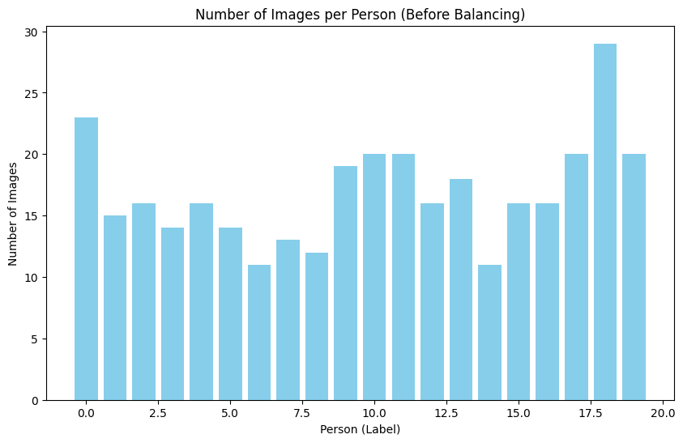
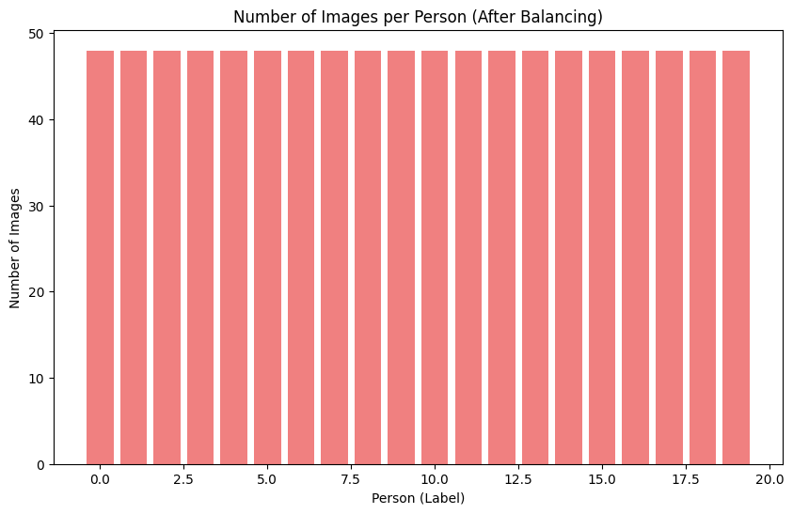
Class Imbalance

Slide 4
Preprocessing Techniques
PCA (Principal Component Analysis)
Reduced dimensionality of the dataset while keeping 99% variance.
Images reduced from 10800 features to only 400 features, improving efficiency and reducing processing time.
CNN for Feature Extraction
Captures hierarchical features from images, effectively identifying subtle differences between classes.
Extracted features help clustering algorithms like K-Means better group data.
Autoencoders
Purpose: Learns a compressed, lower-dimensional representation of images, focusing on essential features.
Architecture: Dense layers with Leaky ReLU activations, L2 regularization, and MSE loss for reconstruction accuracy.
Preprocessing: PCA applied first to reduce dimensionality, enhancing efficiency and performance in feature extraction.

Slide 5
Clustering Techniques
K-Means:
Simple and efficient clustering algorithm based on centroids.
Tuned using silhouette score to determine optimal clusters.
Results: 19 clusters (PCA), 28 clusters (CNN), 24 clusters (PCA + Autoencoders).
DBSCAN:
Density-based clustering without the need to specify the number of clusters.
Results: 33 clusters using PCA.
Gaussian Mixture Model (GMM):
Probabilistic model that considers data as a mixture of Gaussian distributions.
Results: 15 clusters with AIC for model selection.
HDBSCAN:
Hierarchical DBSCAN that handles varying densities across the dataset.
Results: 28 clusters with CNN as preprocessing.

Slide 6
Clustering Results and Insights
Summary of Clusters:
K-Means: Varying cluster numbers depending on preprocessing method.
DBSCAN: Adapted to varying densities and noise, 33 clusters with PCA.
GMM: 15 clusters identified using AIC for optimal model selection.
HDBSCAN: 28 clusters, with CNN providing effective feature extraction.
Insight: Different preprocessing methods lead to different clustering structures.
KMEANS CLUSTER ACCORDING TO PREPROCESSING
Preprocessing Technique | Clusters
PCA | 19
CNN | 28
PCA + Autoencoders | 24

Slide 7
Classification Results
Neural Network Classifier Accuracy for different preprocessing and clustering combinations:
PCA + K-Means: 99.11% (Best Accuracy)
CNN + K-Means: 73.96%
Autoencoders + PCA + GMM: 84.96%
DBSCAN + PCA: 98.23%
CNN + HDBSCAN: 93.23%
Conclusion:
PCA + K-Means achieved the highest accuracy.
CNN-based approaches performed relatively worse due to dataset nature.

Slide 8
Conclusions
Preprocessing Techniques (PCA, Autoencoders, Data Augmentation) were crucial for improving model performance.
Clustering Methods: K-Means with PCA produced the best clustering results, while DBSCAN, GMM, and HDBSCAN showed strengths in handling complex, irregular datasets.
Classification Accuracy: Best performance was achieved by combining PCA and K-Means.
Hybrid Approach: A combination of different methods (PCA + K-Means, CNN + HDBSCAN) led to improved clustering and classification results.

